Slide 1


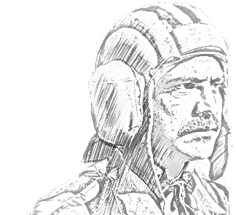
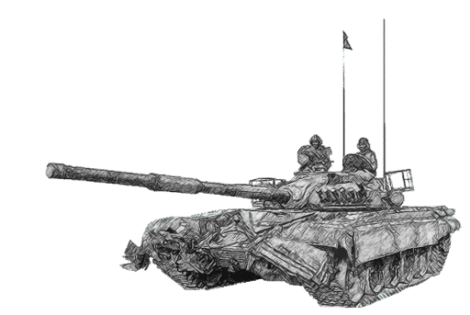
SCHOOL OF TECH TRG
ELECTRONICS WING

Slide 2
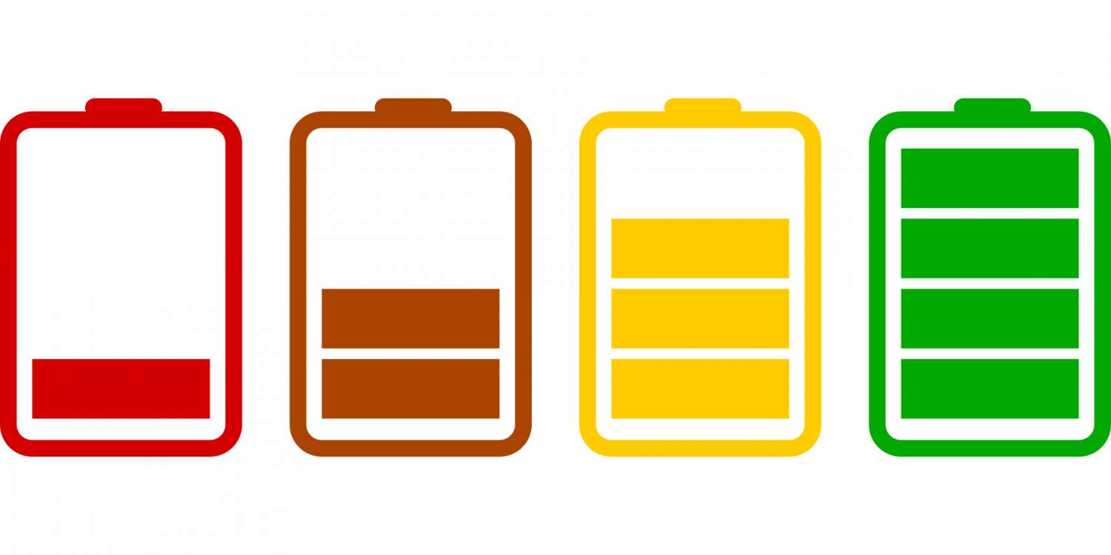
TYPES OF CHARGING

Slide 3
CONDITION OF BTY
How can you know that the battery you are charging, has been fully charged?
How can you know the state of discharge of a battery?

Slide 4
SPECIFIC GRAVITY
The specific gravity of the electrolyte is used to determine both these things.
Specific gravity is the ratio of the density of a liquid to that of water.
A device called hydrometer is used to measure the specific gravity of any liquid.
It changes with temperature.
For a fully charged bty : 1.280
For a fully discharged bty : 1.110

Slide 5
HYDROMETER
The density of any liquid can be checked by observing how the hydrometer floats in a liquid(electrolyte).
It floats higher in a denser liquid as compared to a rarer liquid.
Press the tip of the hydrometer, it will draw some liquid inside it.
A floating bulb gives indexed readings.
The reading may vary with TEMPERATURE.

Slide 6
HYDROMETER
There are two types of hydrometers
  Float type (readings 1100-1300)
  Ball type (white, green and red)
Ball type
  When three balls float - fully charged
  White ball sinks - ¾ charged
  White and green ball sinks - ½ charged
  White, green & red ball sinks - fully discharged

Slide 7
DIFFERENT TYPES OF CHARGING
Types
  Initial charge.
  Normal charge.
  Gassing/Trickling charge.
  Float charge.

Slide 8
INITIAL CHARGE
This type of charging is done when the bty is initially received from the ordnance.
Done by the second line EME workshop.
Procedure
  Fill up bty with electrolyte of 1.250 SG and keep for 12 hours.
  After 12 hours, charge the bty at a rate of AHC/20 for 50 hours.
  Disconnect the bty when the SG becomes 1.285 and EMF is 2.7 volts.

Slide 9
NORMAL CHARGE
This type of charging is done after the bty gets discharged during day to day use.
Procedure
  Charge the bty at AHC/10 for 10 hours.
  If the temperature goes above 60 degrees then charge it for 8 hours.

Slide 10
TRICKLING CHARGE
It is also known as Gassing charge.
This is done when the bty is not used for a long time.
Procedure
  Charge the bty at AHC/20 till free gassing starts.

Slide 11
FLOAT CHARGE
This type of charging is done when the bty is being used that means charging is done simultaneously.
The charging rate is AHC/10.

Slide 12
VOLTAGE RATINGS
This is the emf delivered by the bty when no-load is connected across it.
The emf delivered by a bty reduces when it gets connected to a load.
The voltage rating of a bty can be increased by using more cells in series.

Slide 13
CURRENT RATINGS
This is the amount of current a bty can supply.
The rating is given in ampere-hours.
If a bty is rated 100 AHC, it can supply 20 ampere current for 5 hours.
The current rating of a bty can be increased by using more cells in parallel.

Slide 14
MULTIPLE-CELL BATTERY
In most applications, the voltage and current that can be supplied by a single cell is not enough, so many batteries have to use combinations of cells.
When a higher voltage is needed, cells are connected in series, so that their EMFs add. The cell can be connected within the batteries to obtain the higher voltage.
To increase the current rating, cells must be connected in parallel. Then each cell will supply its own current, and the sum of all the cells will be the total current rating.
By connecting cells in series- parallel combinations, higher voltage and current rating can be obtained.

Slide 15
INTERNAL RESISTANCE OF A BTY
Internal resistance is the opposition that the electrodes and the electrolyte give to the flow of current.
As the bty gets older the internal resistance increases.
Due to this the output voltage of the bty drops when it is supplying current.
The internal resistance of a single dry cell is around 0.2 ohms.

Slide 16
PRINCIPLES OF BTY CHG
1. MAX NO OF BTYS SHOULD BE CHARGED AT THE CORRECT RATE.
2. MAX OUTPUT OF CHG ENG SHOULD BE UTILISED.
3. BTY SAFE CHG RATE = AHC/X
WHERE X = TYPE OF CHARGE.

Slide 17
CALCULATIONS FOR BTY CHG
ENG OUTPUT IN VOLTAGE
BTY IN SERIES = ------------------------------------
BTY SAFE CHG VOLTAGE
ENG OUTPUT IN AMPERE
BTY IN PARALLEL = ----------------------------------
BTY SAFE CHG RATE
TOTAL BTY = BTY IN SERIES x BTY IN PARALLEL

Slide 18
EXAMPLE
Q: HOW MANY BTYS OF 6 VOLTS AND 170 AHC CAN BE CHARGED WHEN ENG’s OUTPUT IS 40 V AND 55 AMP?
ANS: SAFE CHG RATE = 170/10 = 17 AMPS
SAFE CHG VOLTAGE OF 6 V BTY = 3x3 = 9 V
BTY IN SERIES = 40/9 = 4 BTY
BTY IN PARALLEL = 55/17 = 3 BTY
TOTAL BTYS = 4x3 = 12 BTY

Slide 19
BTY CHARGING CCT
TO ENSURE THE SAFETY OF THE BTY AND THE CHARGING ENG THERE IS A PROVISION OF A SAFETY CCT.

Slide 20
SIMPLE CHARGING CIRCUIT
S 1
FUSE
CUT OUT
SOURCE
GEN
V
S2
NOR
A
BTY
RHEOSTAT
BTY

Slide 21
CUT OUT
FUNCTIONS :-
1. PREVENTS DISCHARGING OF BTY.
2. PREVENTS OVER CHG OF BTY.

Slide 22
CUT OUT
-
SPRING ARMATURE
DC GEN
-
CONTACT
PIVOT
+
NO-1
WINDING
+
BTY
HIGH RESISTANCE COIL
NO-2
WINDING
V
RHEOSTATE
A

Slide 23
SAVES BTY FROM DISCHARGE
IF GEN S/W OFF OR OUTPUT BECOMES ZERO.
CURRENT STOPS FLOWING THROUGH W1.
C DEMAGNETISES.
CONTACT PT DISCONNECTS FROM ARMATURE.
STOPS ANY REVERSE FLOW OF CURRENT.

Slide 24
SAVES BTY FROM OVERCHARGE
WHEN BTY VOLTAGE BECOMES MORE THAN GEN OUTPUT.
FLOW OF CURRENT REVERSES.
REVERSE CURRENT CHANGES POLARITY OF C.
THIS INDUCES A BACK EMF IN ‘C’ AND IT DEMAGNETISES.
THE CONTACT BREAKS.
NO OVERCHARGE.

Slide 25
SECONDARY BTY DEFECTS
Sulphation
Buckling
Sedimentation/Sludge
Treeing

Slide 26
SULPHATION
Lead sulphate particles accumulate on plate of the bty, stops chg and short circuiting occurs.
Symptoms
White patches appear on plates.
Cannot charge the bty.
Reasons
Due to over charge and under chg.
Bty kept unused in discharged condition.
Topping up with acid in place of water.
Using bty in high temp for long durations.
Keeping electrolyte level low.

Slide 27
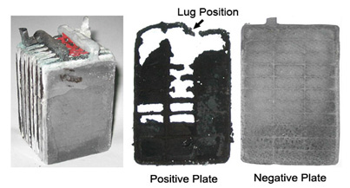
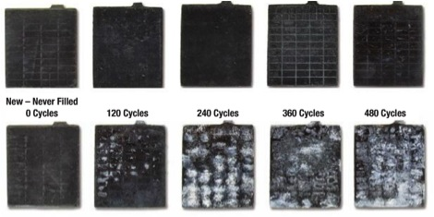
SULPHATION

Slide 28
SULPHATION
Remedy
  Charge bty at AHC/20 till free gassing.
  Discharge at low rate.
  Charge at AHC/40.
  Discharge at low rate.
  Repeat entire process till voltage is 2.7 v and SG is 1.285.

Slide 29
BUCKLING
Plates bend and tend to touch each other there by short circuiting this is generally the defect of the positive plate which is softer as it is made of lead (50%) there is no remedy for this defect, defective bty has to be returned to the wksp.
Reasons
Short circuiting of bty terminals.
Due to over charging and under charging.
Due to discharging at higher rate.
Due to sludge formation.
Due to excessive gassing (while chg).

Slide 30
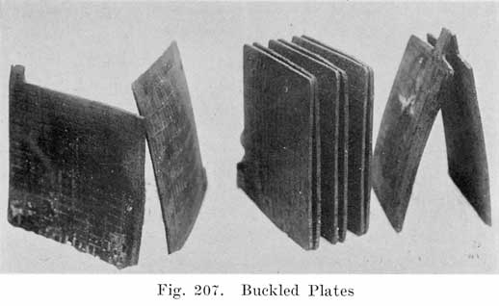
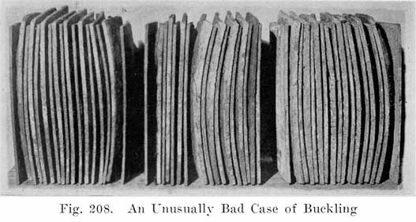
BUCKLING

Slide 31
BUCKLING
Symptoms
  Bent plates.
  Touching of plates.

Slide 32
SEDIMENTATION / SLUDGE
  On the plates lead peroxide particles are formed. They fall of from the plates and mix with electrolyte and this results in short circuiting.
  Symptoms
  Electrolyte turns brownish
  Capacity of bty reduces.
  Internal short circuiting leading to discharging of bty.

Slide 33
SEDIMENTATION / SLUDGE
  Reasons
  Excessive gassing.
  Bad handling.
  Vibration.
  Remedy
  Drain out all electrolyte.
  Clean the bty with water.
  Fill with new electrolyte.
  Give initial charge ie > AHC/20.

Slide 34
TREEING
Lead sulphate and lead oxide intermingle between the plates and in the electrolyte due to excessive gassing or when the bty is heated up these particles come up and form tree like shape.
Symptoms
Short circuiting (sparking at terminals)
Treeing effect can be seen in a transparent bty.

Slide 35
TREEING
Reasons
1. Sulphation, buckling,sludge.
2. Excessive gassing.

Slide 36
TREEING
Scrap off plate with an ebonite rod and wash up the bty with water
Send bty to the wksp.

Slide 37
BTY MAINT

Slide 38
ACTIONS TO BE TAKEN BY AN OPR
Ensure bty is clean and dry at all time.
Periodically clean bty terminal and apply mineral jelly.
Keep air vent plugs clean and holes of plug open.
Electrolyte level to be 3/8 inches above the level of plates
Check bty case for repairs.
Check the carrying handle.
7. Check bty voltage and specific gravity.

Slide 39
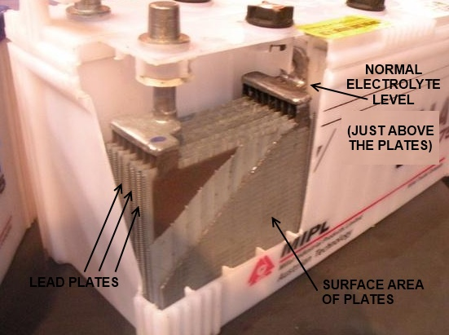

Slide 40
INSTRUCTIONS FOR BTY CHARGING
1. Keep bty on level grnd.
2. Always use wires of correct amperage for charging.
3. Open air vent plugs.
4. Check electrolyte level.
5. Charge bty at specified rate.
Check SG and bty voltage after every 2 hrs.
Before disconnecting the bty, s/w off the generating / charging
engine.
8. After charging keep bty safe from naked fire/ short circuiting.
9. While charging if possible have an exhaust or make sure air ventilation is proper.

Slide 41
CORRECT USE OF BTY
1. Correct handling and protect from damage.
2. After initial charge do not keep the bty in unused state.
3. Protect bty from under discharge and over charging.
4. Keep record of bty charging on bty log sheet.
5. Each bty should be charged once a week if it has not been used.

Slide 42
PROCEDURE FOR BTY STORAGE IN CHARGED CONDITION
1. Charge the bty to full voltage and SG.
2. Drain out the electrolyte.
3. Fillup with distilled water to keep for 24 hrs.
After 24 hrs take out distilled water to store the bty.
If you find that the temp is more , then fill it again
with distilled water to drain out electrolytes and store the
bty .

Slide 43
PROCEDURE FOR BTY STORAGE IN DISCHARGED CONDITION
1. Charge the bty to full voltage and SG.
2. Drain out the electrolyte and fill it with distilled water.
3. Discharge the bty all by all.
4. Remove the distilled water and store the bty.

Slide 44
JAI HIND

